Slide 1


FINAL: Introduction to Finance
Developing an Investment Proposal for a Blockchain-Based Real Estate Transaction Platform
Team members: Alibek Tleubergenov, Beksultan Shaikhy, Imanzhusip Saparbek

Slide 2


Contents
01/
Introduction
02/
Problem Statement and Market Opportunity
03/
Solution Overview
04/
Business Model and Revenue Streams
05/
Market Analysis and Competitive Landscape
06/
Financial Projections and Funding Requirements
07/
Team and Advisors
08/
Risk Assessment and Mitigation Strategies’
09/
Call to Action for Investors
010/
Conclusion

Slide 3


01/
Introduction
Overview:
BlockEstate is a platform designed to streamline real estate transactions using blockchain technology. By reducing reliance on intermediaries and ensuring transparency, BlockEstate aims to make real estate transactions faster, cheaper, and more secure.
Objective:
To attract investment for further development and expansion of BlockEstate in the growing PropTech space.

Slide 4
02/
Problem Statement and Market Opportunity
Problem Statement:
Traditional real estate transactions are often delayed, costly, and prone to fraud.
Current systems rely on multiple intermediaries (agents, title companies, etc.), which increases costs and risks.
Real estate fraud cases are rising, with identity theft, title fraud, and double-selling being common issues.
Market Opportunity:
Global real estate is a $280+ trillion market with a growing demand for technology-driven solutions.
Increasing acceptance of blockchain and digital solutions within the industry presents a clear opportunity for a platform like BlockEstate.
High potential for adoption among tech-savvy users and professionals seeking cost-effective, transparent alternatives.

Slide 5
03/
Solution Overview
Overview of BlockEstate’s Solution:
Smart Contracts: Automates processes, reducing the need for intermediaries and minimizing human error.
Decentralized Digital Identities: Ensures only verified participants can transact, reducing fraud risk.
Immutable Ledger: Uses blockchain to create unalterable property records, enhancing transparency.
Tokenized Ownership: Enables fractional ownership, allowing more individuals to invest in real estate through tokenization.
Benefits:
Faster, cheaper, and more secure transactions.
Broader access to real estate investments through fractional ownership.

Slide 6


04/
Business Model and Revenue Streams
BUSINESS PROCESS
Revenue Streams:
Transaction Fees: Low transaction fees are charged per completed transaction, providing a steady revenue source.
Professional Subscriptions: Real estate professionals can subscribe to access premium tools and analytics.
Premium Services: Optional services, such as legal document generation and escrow, offer added functionality for users.
Target Users:
Individual buyers and sellers, real estate professionals (agents, brokers), and institutional investors.

Slide 7
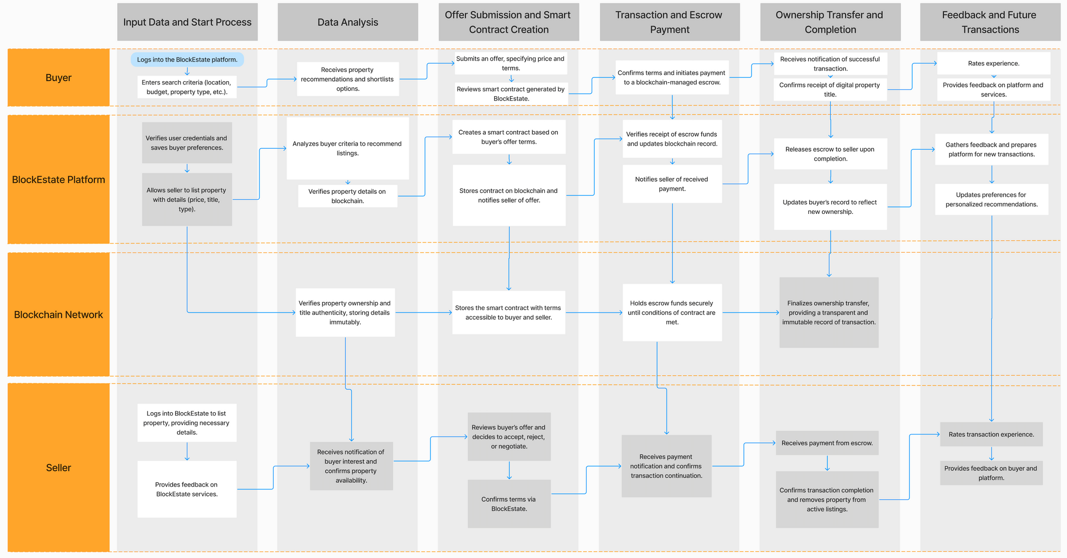
Business process

Slide 8
05/
Market Analysis and Competitive Landscape
Target Market Segments:
Individual Buyers and Sellers: Simplified, lower-cost transactions.
Real Estate Professionals: Advanced analytics and management tools.
Institutional Investors: Access to fractional ownership for broader portfolio diversification.
Competitive Landscape:
While some competitors like Propy and RealT offer blockchain- based property solutions, BlockEstate differentiates itself by:
Offering a wider range of premium services.
Supporting tokenized ownership and fractional investment.
Leveraging a hybrid revenue model to appeal to diverse user needs.

Slide 9

06/
Financial Projections and Funding Requirements
Funding Requirements:
Total Required Investment: $2 million
Allocation:
Platform Development: $1 million
Marketing and Customer Acquisition: $500,000
Operations and Staffing: $300,000
Legal and Compliance: $200,000
Revenue Projections:
Year 1: $1 million in revenue from transaction fees and basic subscriptions.
Year 3: $5 million as the platform gains traction and premium services expand.
Year 5: $10 million from transaction fees, subscriptions, and premium services.

Slide 10
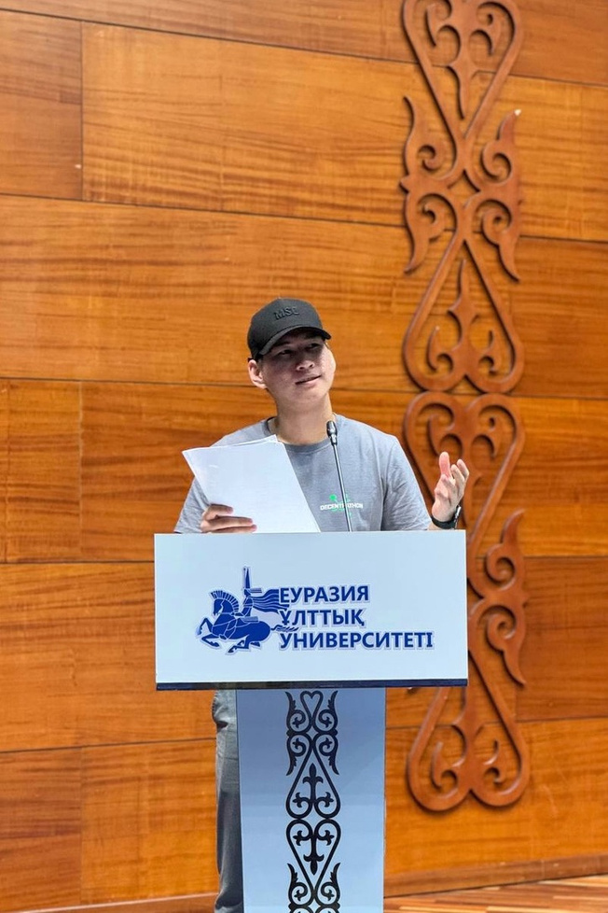


07/
Team and Advisors
Core Team:
Alibek Tleubergenov: Expertise in blockchain development and architecture.
Beksultan Shaikhy: Background in real estate technology and finance.
Imanzhusip Saparbek: Specialist in PropTech strategy and business operations.
Advisors: Professionals in blockchain technology, real estate law, and finance who guide BlockEstate’s strategy and ensure compliance with regulations.

Slide 11
08/
Risk Assessment and Mitigation Strategies
Technical Risks:
Challenge: Ensuring a secure, scalable platform.
Mitigation: Employ experienced blockchain developers; conduct regular testing and phased rollouts.
Market Risks:
Challenge: Uncertain market adoption.
Mitigation: Focused marketing and strategic partnerships to educate users and drive adoption.
Operational Risks:
Challenge: Managing operational growth and maintaining quality.
Mitigation: Invest in scalable infrastructure and customer support.
Regulatory Risks:
Challenge: Adherence to real estate and data privacy regulations.
Mitigation: Legal advisors ensure compliance; use of a consortium blockchain for privacy.

Slide 12
09/
Call to Action for Investors
Why Invest in BlockEstate?
High Market Potential: Real estate is a vast, growing industry in need of modernization.
Scalable and Sustainable Revenue Model: Diverse income streams support steady growth and adaptability.
First-Mover Advantage: Blockchain technology in real estate is still emerging, allowing BlockEstate to establish itself as a leader.
Social Impact: BlockEstate democratizes access to real estate investment through tokenization and fractional ownership.
Next Steps:
Invitation to Invest: Join us in transforming the real estate market with a cutting-edge blockchain solution.
Potential Returns: Early investors stand to benefit from BlockEstate’s projected growth and future market expansion.

Slide 13



010/
Conclusion
In conclusion, BlockEstate is set to transform real estate transactions by making them faster, more affordable, and secure through blockchain technology. With a diverse revenue model, a focus on compliance, and unique features like smart contracts and tokenized ownership, BlockEstate stands out in a competitive market. We invite investors to join us in revolutionizing the real estate industry, tapping into a high-growth opportunity with the potential for substantial returns.

Slide 14
FINAL
Thanks for your attention!
Introduction to Finance

